Slide 1
Cloud Migration
Onboarding Meeting

Slide 2
Agenda
Introductions
Scope
Cloud Migration Process overview
Pre-Requisites
Example Plan
Teams
Questions

Slide 3
Introductions
Name | Role | Email
PROVIDE DETAILS OF WHO WILL BE INVOLVED
Service Team |  | AdvancedServicesPMO@tdsynnex.com
Team Site | Main Communication Channel for Migration project | PROVIDE LINK HERE

Slide 4
Cloud Migration Scope
Confirm the scope for the migration:
Has Migration Evaluator been completed? (optional)
Setup type – Physical, VMWare, VCentre
X non-standard Servers to be migrated
  Details of these servers
Any additional scope/notes

Slide 5
Cloud Migration Process Overview
Partner
Signed SOW & PO
Complete Pre-requisites
Review Migration Design
Test Failover
Go/No Go Decision
UAT Testing
TD SYNNEX
Create Teams Site
Review Migration Evaluator Output(Optional)
Onboarding Call
Install Migration Tools
Create Migration Plan
Complete Migration Design
Validate Scope
Carry out migration
Final Cutover
Migration Report
Post Migration Support

Slide 6
Cloud Migration Pre-Requisites
VPN details for On-Premise Environment Access
Domain Admin credentials
  If the servers are not in domain, then local ddmin credentials for the servers will be required.
SQL Server credentials (if applicable)
If VMWare environment:
  VMWare vCenter credentials
If Hyper-V environment:
  Hyper-V Host Credentials
On-premise Network Architecture Diagrams
On-premise Firewall Make & Model
On-premise network address range
On-premise networks IP Range
AWS Subscription login details
Preferred AWS region
AWS VPN type: Standard or Accelerated
Pre-shared key for VPN Connection
AWS Resource Naming convention (ResourceGroup, VMName, VPC, Subnet, VPN Gateway)
AWS VPC/Subnet IP Range (should not overlap with on-prem IP Range)
  Number of subnets and their IP ranges, respective server for each subnet
Confirm the Discovery Timelines - 5 day Performance Counters (If rightsizing still to be done)
Finalise Inventory List
Note that during the Migration Design, additional requirements may be identified.

Slide 7
Prerequisites for Agentless Migration (VMWare environments)
AWS account
  AWS Migration Hub will be configured on home region for purposes of discovery, planning, and migration tracking.
An AWS Identity and Access Management (IAM) user in the console with existing AWSApplicationDiscoveryAgentlessCollectorAccess, DMSCollectorPolicy and FleetAdvisorS3Policy IAM managed policies attached. These policies allows the user to perform necessary data collection actions.
VMware vCenter Server V5.5, V6, V6.5, 6.7 or 7.0.
For VMware vCenter Server setup, customer must provide vCenter credentials with Read and View permissions set for the System group.
Amazon S3 bucket in the AWS Region needs to be created that can be set as Migration Hub home Region. This is to be used by database and analytics data collection modules to store inventory metada.
For Discovery. download and deploy the Agentless Collector Open Virtualization Archive (OVA) file. The Agentless Collector is a virtual appliance that needs to be installed in the on-premises VMware environment.
Agentless Collector virtual machine specifications:
  Operating System – Amazon Linux 2
  RAM – 16 GB
  CPU – 4 cores
Agentless Collector requires outbound access over TCP port 443 to several AWS domains. For a list of these domains, see https://docs.aws.amazon.com/application-discovery/latest/userguide/agentless-collector-gs-prerequisites.html#agentless-collector-gs-prerequisites-firewall
The main Agentless collector limitation is that it cannot “look inside” each of the VMs, and as such, cannot figure out what processes are running on each VM nor what network connections exist. To overcome this limitation, for VMs hosted on VMware, we can use both the Agentless Collector and Discovery Agent to perform discovery simultaneously.
For migration, it is required to install the AWS MGN vCenter Client in your vCenter environment.
The AWS MGN vCenter Client installer only supports vCenter 6.7, 7.0 and 8.0.
The MGN vCenter Client can be installed on the following 64 bit Linux versions:
  Ubuntu 18.x+ (64 bit) - 22.04
  Amazon Linux 2
  RHEL 8.x
Optional performance requirements for AWS MGN vCenter Client:16 GiB RAM, 8 cores, 10 GiB of free disk space
AWS MGN vCenter Client VM must have outbound and inbound network connectivity to the AWS Application Migration Service API endpoints and outbound and inbound network connectivity to the vCenter endpoint.

Slide 8
Prerequisites for Agent based migration – Physical and Hyper-V environments
AWS account
  AWS Migration Hub will be configured on home region for purposes of discovery, planning, and migration tracking.
For discovery, we need an AWS Identity and Access Management (IAM) user in the console with existing AWSApplicationDiscoveryAgentAccess IAM managed policy attached. This policy allows the user to perform necessary agent actions.
List of supported Operating Systems: Supported operating systems - Application Migration Service (amazon.com)
For discovery, discovery agent needs to be installed on each VM to migrate
Access to Amazon S3 in the home region is required for auto-upgrade to function.
For discovery, if outbound connections from the customer’s network are restricted, then the firewall settings needs to be updated. Agents require access to arsenal over TCP port 443. They don't require any inbound ports to be open. For example, if the home region is eu-central-1, then we use https://arsenal-discovery.eu-central-1.amazonaws.com:443
For migration, AWS Replication Agent needs to be installed on each VM to migrate
For migration, ensure the following network requirements: Network requirements - Application Migration Service (amazon.com)

Slide 9
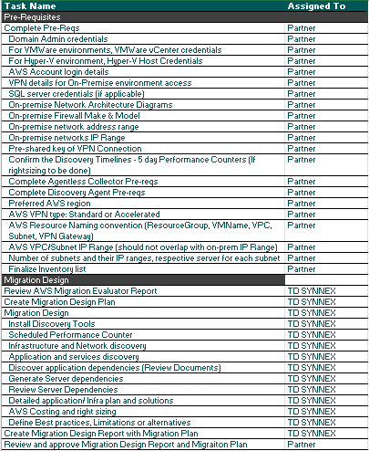
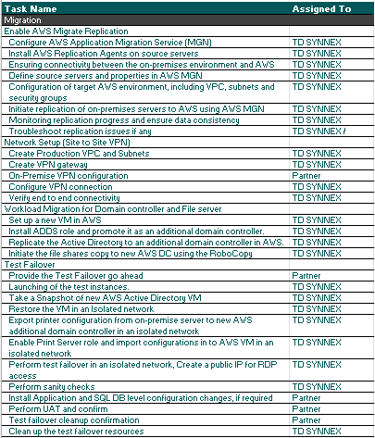
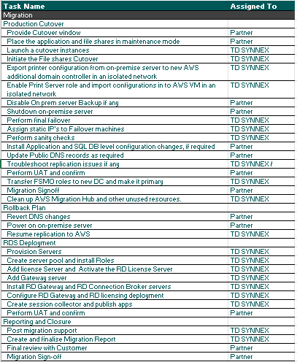
Example Project Plan

Slide 10
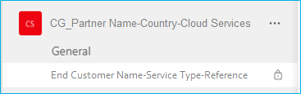
Cloud Migration Teams Channel
We use Microsoft Teams for communication during the project. You will receive an invitation to the Team and the Channel that we will use. Both the Team and the Channel will be ‘private’ this means that only people that have been invited will be able to see them and the content within them. In this way we can make sure that only the appropriate people can access the information for the project.
This is also where any documents should be shared and worked on.
Using Teams makes sure there is a single place that contains all the latest documents, decisions and details for the projects. It also reduces the number of emails that go back and forward and allows all members of the project to have access to all the information.
This is the TEAM – Teams are created at a Partner level and can contain multiple Channels - this is where the link will take you. Under the Team you will see the Channels that you have access to
This the is the GENERAL CHANNEL – This is created by default when the Team is created, and all Team Members will have visibility of the Channel and content. Due to this, this Channel is locked, and will not have any project specific content.
This is the CHANNEL – Channels are created at a project level - this is where the conversations and documents for a specific project will be found. You will only see Channels that you are a member of.
When you click on the link provided you will normally be asked if you want to open in the Desktop App or in the Web App
Within Teams you can switch between the accounts you have access to – e.g. the TD SYNNEX account and your ‘home’ account
Make sure you update your settings so that you get notifications for any messages – selecting the Emails for missed activity is especially important if you switch between different instances of Teams (e.g. your company Team and the TD SYNNEX Team)

Slide 11

Questions

